Slide 1
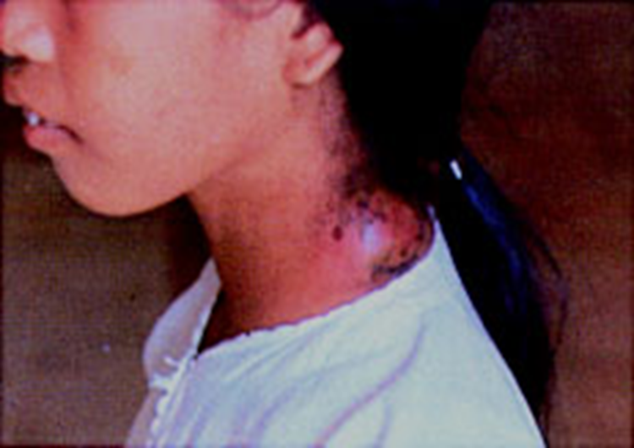
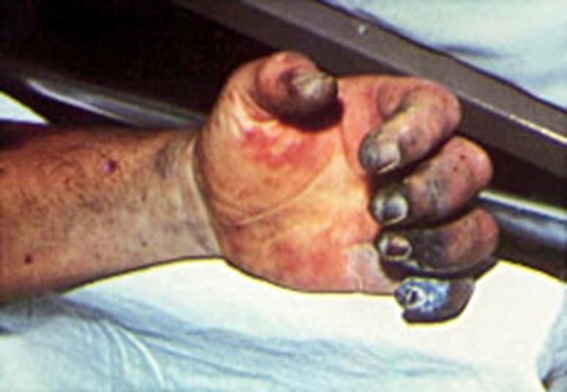
Tue. 12/18
No warm-up today! Please submit all warm-ups from last week and Monday on my desk with your name on it. Pick up a packet on the Black Plague and let’s get started!

Slide 2
Black Death Skit
Narrator Katrina
Parson ALex
Roger Tyler Nora
Peddler Jenna
Geoffrey Smith Derek
Lawrence Tustin Grace
Bartholomew Thomasyn Isaac
The Reeve Miranda F
Thomas Cooper Miranda C
Mrs. Tyler Sarena
Tyler’s Aunt Neelan
Woman Walker
Woman’s husband Laurie
Clerk Kelsey
Monk Jenny
Michael Akroyd Andrew
David Lloyd Damian
Mad Meg Mary

