Slide 1
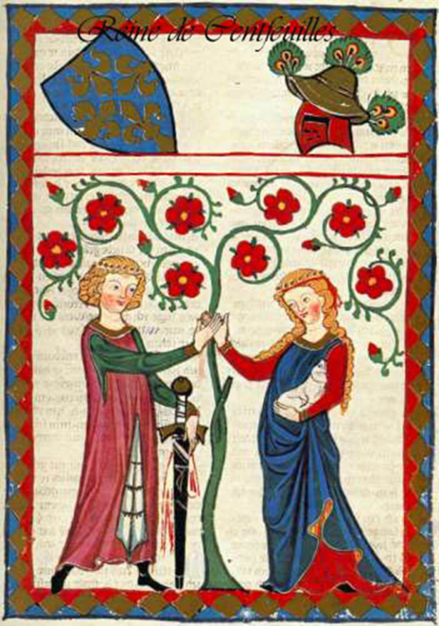
Warm-Up Mon. 12/17
Stack your answers to Friday’s Crusades packet on the desk. Continue warm-ups on last week’s warm-up paper.
1.) When a man and a woman are on a date, what should they each do?
2.) Are there rules for fighting?

Slide 2
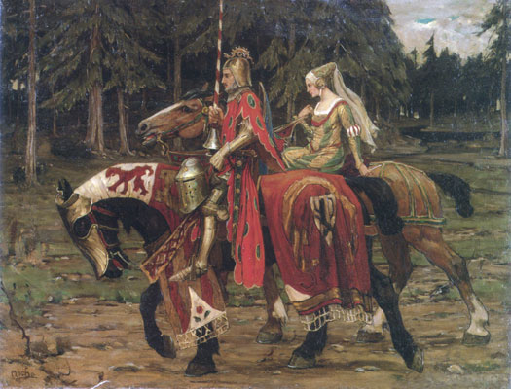
Chivalry
A code of conduct for knights
A.) Fighting
1. No backstabbing
2. Challenge (with gauntlet)
3. Honor (better to lose with honor)
B.) Loving
1. One true love – often forbidden (Lacelot, Tristan)
2. Women are delicate and need protection
3. Troubadour – Chansons de geste/romance
Notes:
Songs of heroic deeds

