Slide 1
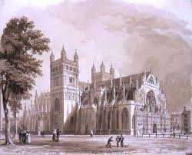
Warm-Up Tue. 12/11
How did the Roman Catholic Church control power in Middle Age Europe? Give examples.

Slide 2
Crime and Punishment in Middle Age Europe
Read through the punishments for committing a crime. Put a star next to the one you think would produce the most just determination of whether or not a person is telling the truth.
Read through the crime worksheet. Create some visual that answers these questions. Be creative!
1.) What are the three different types of courts?
2.) What crimes did they handle and why?
3.) What is the Church’s relationship with the law?
4.) What are the different levels of punishment?

